Slide 1
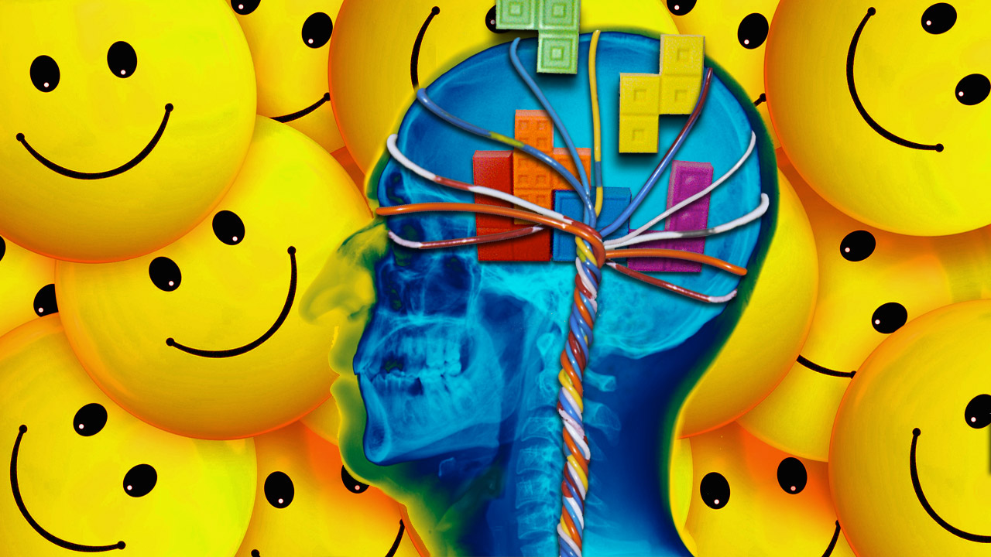
Positive Psychology
An Introduction

Slide 2
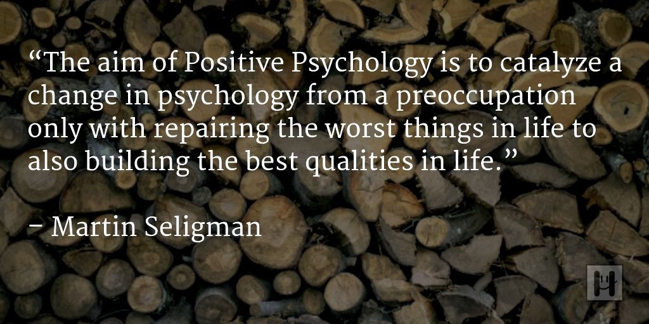

Slide 3
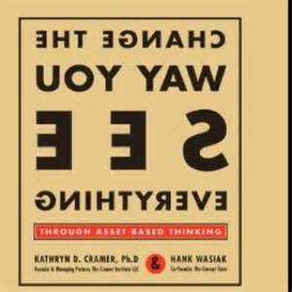

Slide 4
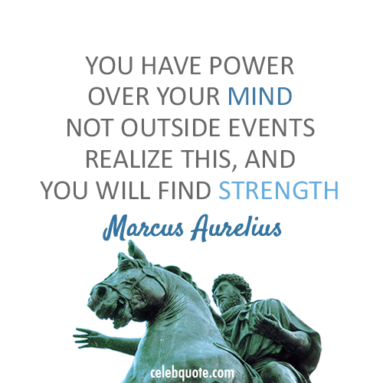

Slide 5
Positive Psychology
The scientific study of positive human functioning and flourishing on multiple levels that include the biological, personal, relational, institutional, cultural, and global dimensions of life
--Seligman and Csikszentmihalyi

Slide 6
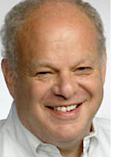
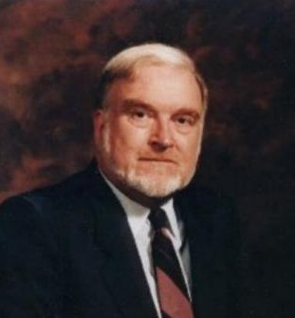
Positive Psychology
Everyday language: The scientific study of what makes life most worth living
Concerned with eudaimonia, or "the good life," a reflection about what holds the greatest value in life – the factors that contribute the most to a well-lived and fulfilling life.

Slide 7
Guiding Theories in Positive Psychology
Seligman’s PERMA
Seligman and Peterson's Character Strengths and Virtues
Csikszentmihalyi's theory of Flow

Slide 8
PERMA

Slide 9
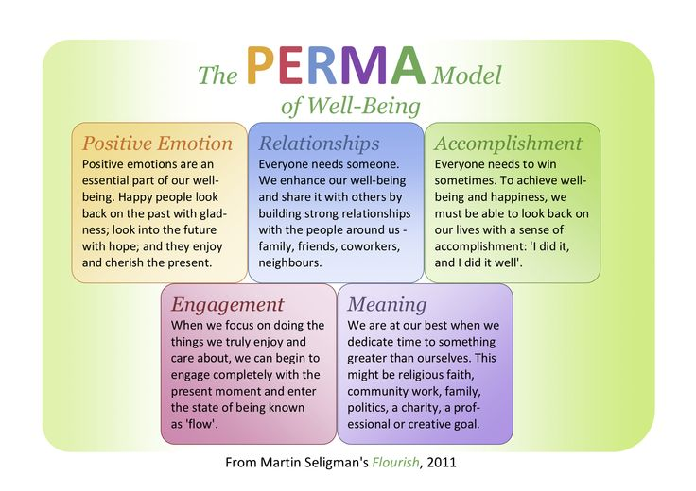

Slide 10
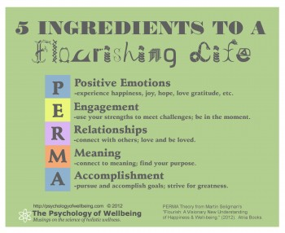
Flourishing
Content of Flourishing: happiness, flow, meaning, love, gratitude, accomplishment, growth, better relationships
PERMA
Positive Emotions
Engagement
Social Relationships
Meaningfulness
Achievement

Slide 11
Positive Emotions
AKA Pleasant Life
Contributes to well-being (In Authentic Happiness Theory, it was the cornerstone of the theory
Happiness and life satisfaction
Measured subjectively
Includes variables of pleasure, ecstasy, comfort, warmth, and the like

Slide 12
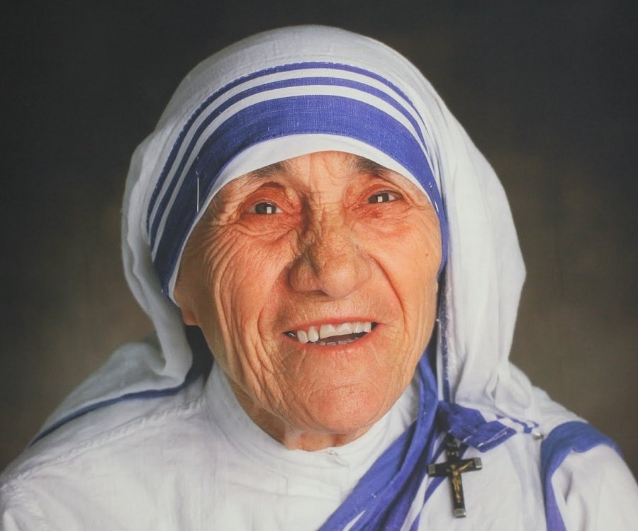
Quote
“Be happy in the moment, that's enough. Each moment is all we need, not more.” ― Mother Teresa

Slide 13
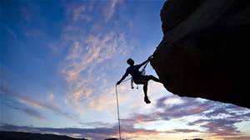
Engagement
AKA Flow
Measured subjectively
Did time stop for you?
Were you completely absorbed by the task?
Did you lose self-consciousness?
Subjective state for engagement is retrospective…since when we are in a flow state
Flow: when our skills are challenged

Slide 14
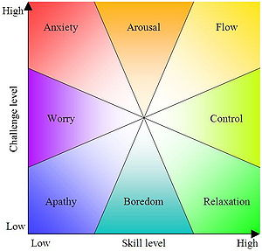

Slide 15
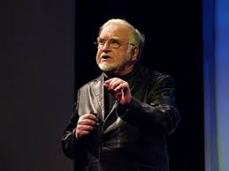
Flow
Flow Talk on Ted

Slide 16
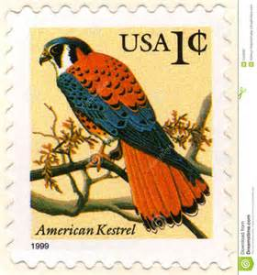
Positive Relationships
Research: doing a kind thing for another produces the single most reliable momentary increase in well-being of any exercise tested
Seligman stamp example
George Valliant: master strength is the capacity to be loved

Slide 17
Meaning
AKA Meaningful Life
Belonging to and serving something that you believe is bigger than the self

Slide 18
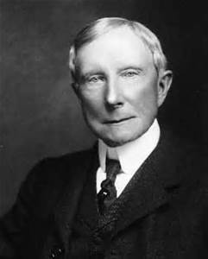
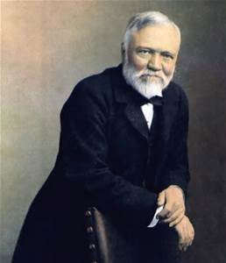
Accomplishment
AKA Achieving Life
Idea that we pursue success, accomplishment, winning, achievement and mastery for their own sakes
Pursuit may not bring positive emotion or meaning, or positive relationships
Tycoons turned philanthropists: Andrew Carnegie, John D. Rockefeller, Bill Gates (created meaning later in life)
“accumulators” or play to win

Slide 19
Flourishing and Strengths

Slide 20
Flourish and Strengths
24 Strengths
Strengths underpin all five elements
Deploying your highest strengths leads to more positive emotion, to more meaning, to more accomplishment, and to better relationships

Slide 21
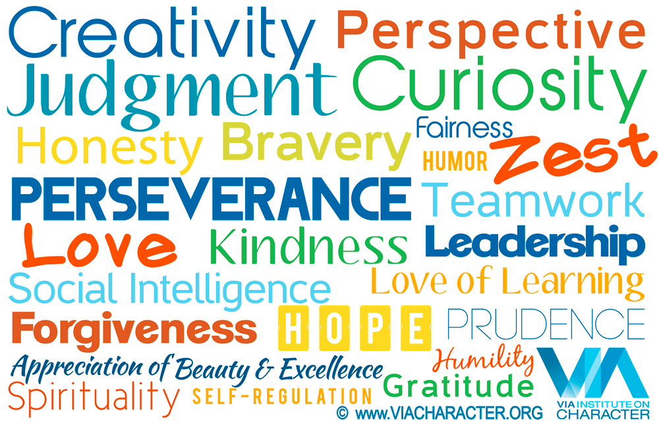
Strengths
http://www.viacharacter.org/www/Character-Strengths/VIA-Classification

Slide 22
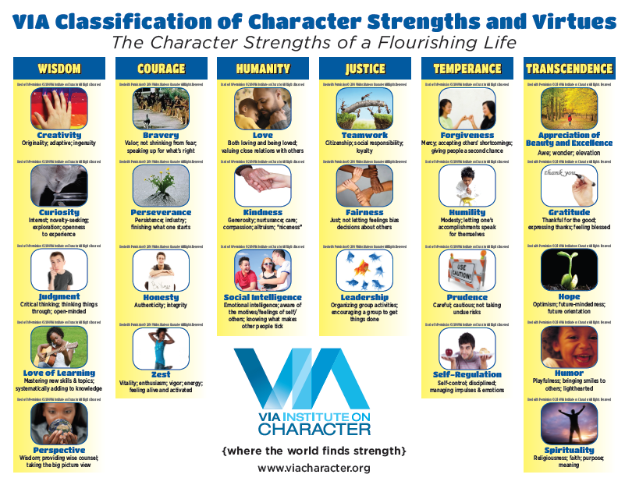

Slide 23
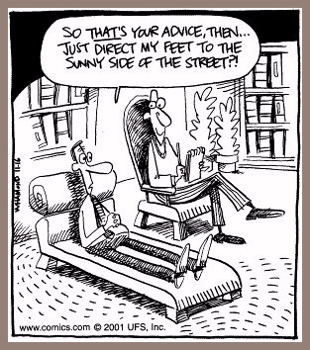

Slide 24
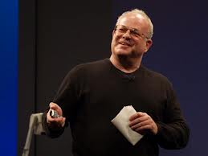
Martin Seligman
Martin Seligman Ted Talk

Slide 25
Positive Psychotherapy Exercises and Tools
Gratitude Journal
Design a Beautiful Day
Self Esteem Journal
Values in Action Survey
Mindfulness Meditation

Slide 26
Gratitude Journal
Be specific
Focus on people
See good things as gifts
Savor surprises
Revise if you repeat something
Write regularly (some recent research suggests 3x/week is ideal
Write in journal up to 5 things for which you are grateful
Can be small in importance (e.g., sunshine) to large (e.g., I got my dream job)

Slide 27

Mindfulness

Slide 28
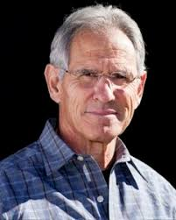
Mindfulness
The practice has moved from a largely obscure Buddhist concept founded about 2,600 years ago to a mainstream psychotherapy construct today (apa.org)

Slide 29
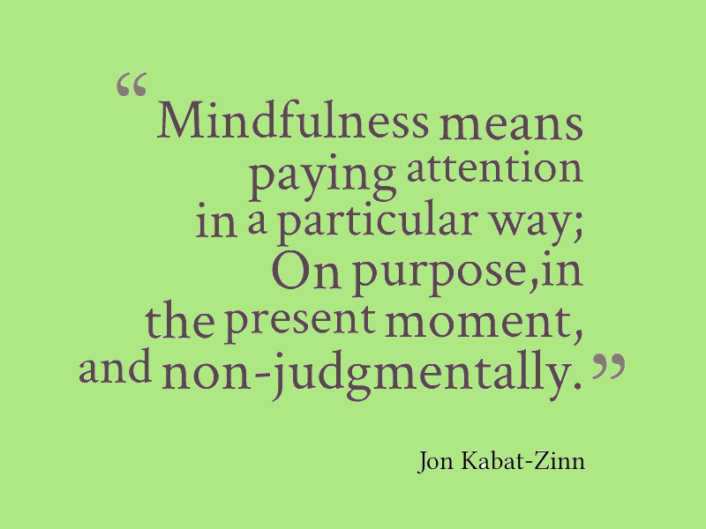

Slide 30
Benefits of Mindfulness
Self-control
Objectivity
Affect tolerance
Enhanced flexibility
Equanimity
Emotional intelligence
Improved concentration and mental clarity
The ability to relate to others and one's self with kindness, acceptance and compassion.

Slide 31
What is Positive Psychology?
Components of Positive Psychology
Scientific and applied approach
Uncovering human strengths while keeping cultural context in mind
Promoting positive functioning

Slide 32
Building Human Strength: Psychology’s Forgotten Mission
Psychology previously had three missions
Post-WWII shift toward researching pathology
Creation of VA and NIMH

Slide 33
Building Human Strength: Psychology’s Forgotten Mission
Our Neglected Missions
Humans seen as passive
Psychologists looked to repair damage
Must nurture what is best within ourselves

Slide 34
Building Human Strength: Psychology’s Forgotten Mission
Building Strength, Resilience, and Health in Young People
Strengths help us resist mental illness
Practitioners must help amplify strengths
Clients can become physically healthier

Slide 35
Going From the Negative to the Positive
A Positive Newspaper Story
Flights delayed in Philadelphia airport
Passengers reacted in a positive manner
Used variety of healthy coping strategies

Slide 36
Going From the Negative to the Positive
Reactions to This Positive Story
Readers responded with praise
Several requests for similar stories
People want to see and hear about the good in others

Slide 37
A Balanced, More Complete View of Human Functioning
Tempting to solely focus on the good or bad
Psychologists adhered to pathology model
Operated within particular circumstances of that time

Slide 38
A Balanced, More Complete View of Human Functioning
Portrayal of humankind is incomplete
Must examine weaknesses and strengths
Need to improve cultural competence

Slide 39
A Balanced, More Complete View of Human Functioning
Views of Reality That Include Both the Positive and the Negative
Reality negotiations and social constructions
Positive and pathology share similar goals
Need to embrace both perspectives

Slide 40
Where We Are Now and What We Will Ask
Martin Seligman initiated the recent push
Logic and science are necessary
Must always consider context

Slide 41
A Guide to This Book
Eight parts, sixteen chapters
Part I: Looking at Psychology From a Positive Perspective
Part II: Positive Psychology in Context

Slide 42
A Guide to This Book
Part III: Positive Emotional States and Processes
Part IV: Positive Cognitive States and Processes
Part V: Prosocial Behavior

Slide 43
A Guide to This Book
Part VI: Understanding and Changing Human Behavior
Part VII: Positive Environments
Part VIII: Finding Strengths in Others: Embodying Strengths in Everyday Life

Slide 44
A Guide to This Book
Personal Mini-Experiments
Use positive psychology in your own life
Similar to research and clients’ homework

Slide 45
A Guide to This Book
Life Enhancement Strategies
Activities related to love, work, and play
Numerous researchers studied the great realms of life

Slide 46
The Big Picture
Previous cultures emphasized virtues
“Darkness cannot drive out darkness…” – Martin Luther King, Jr.
United States could be big contributor

